Slide 1

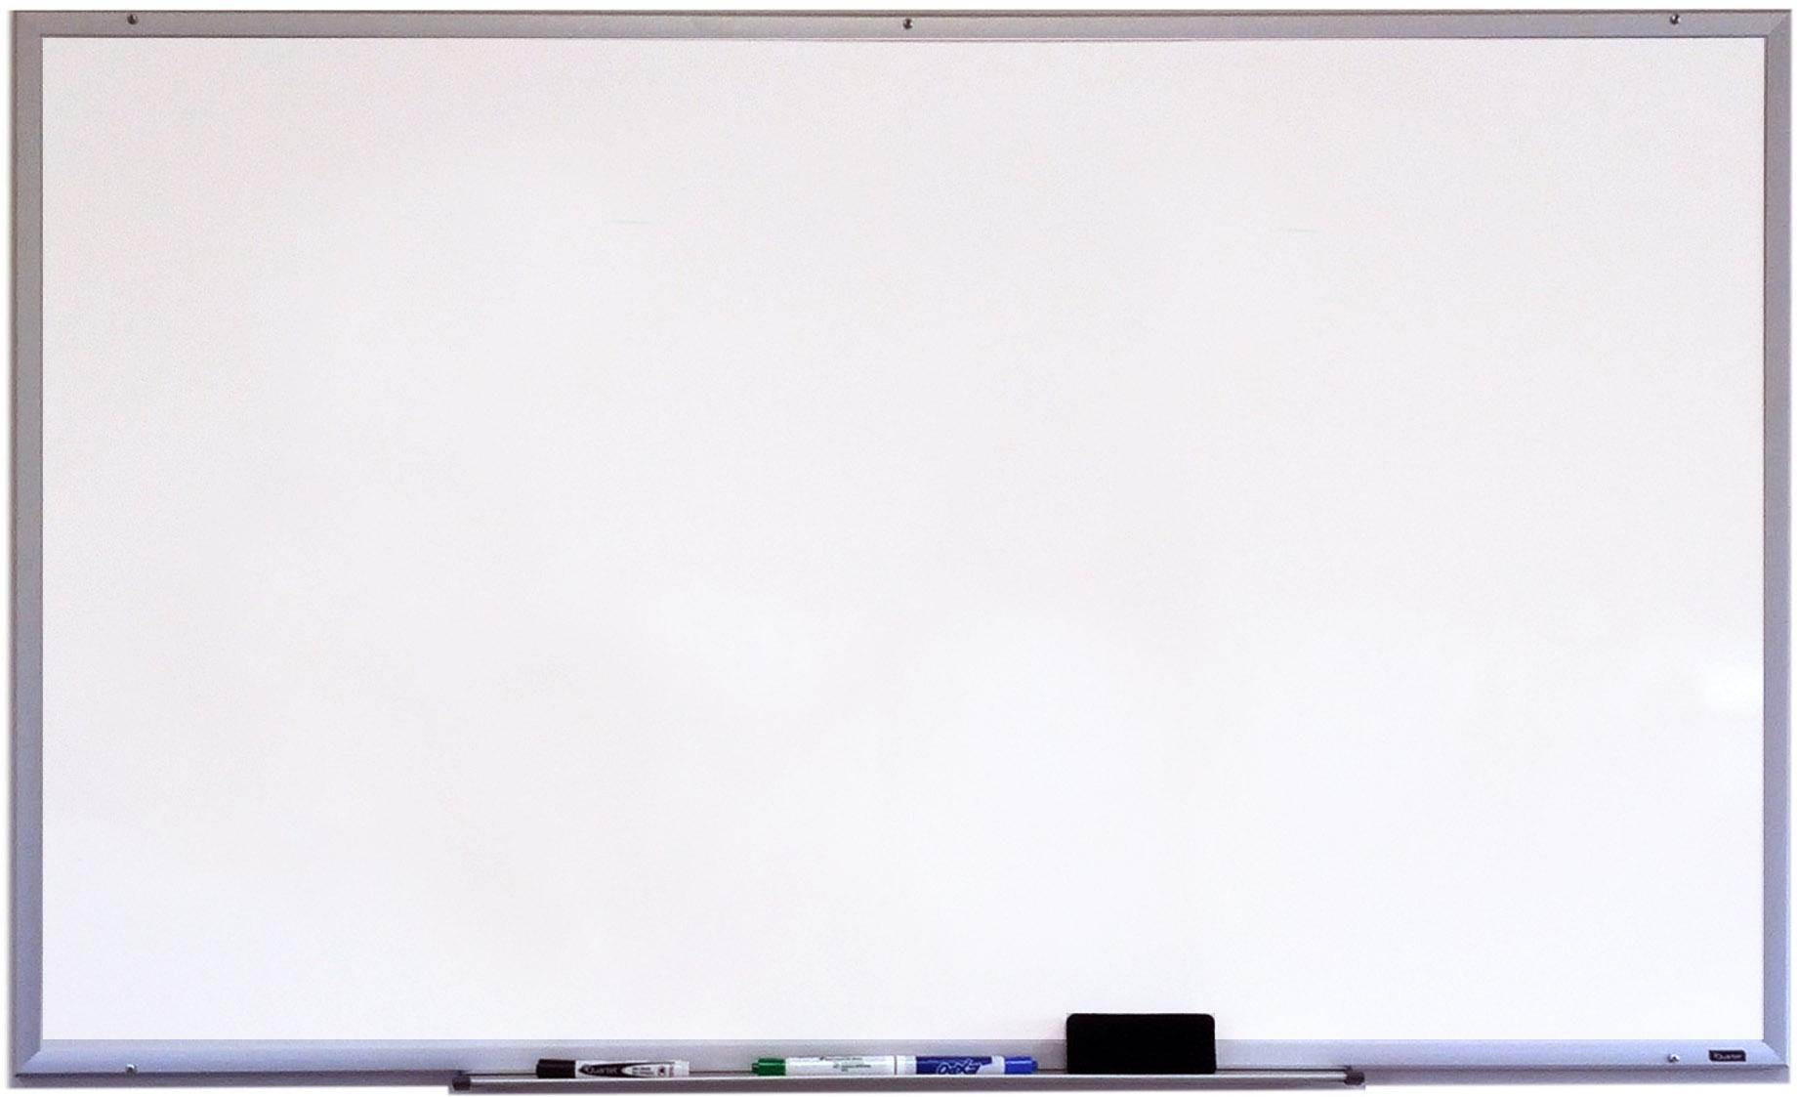

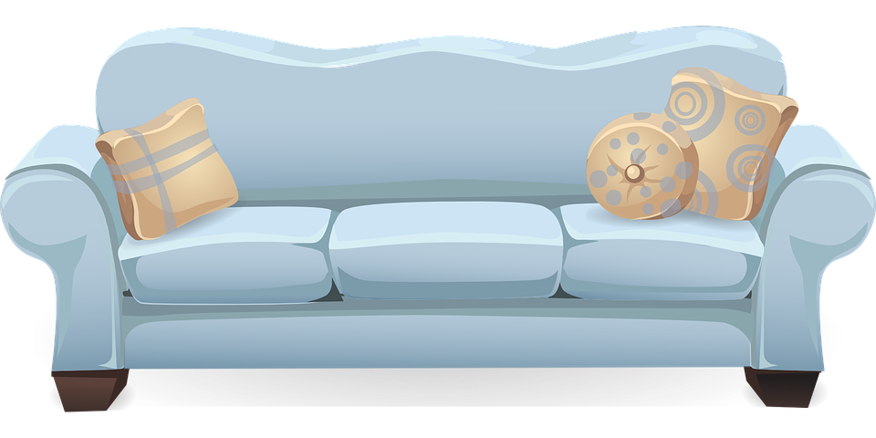
Welcome to Chirton’s Virtual Library!
Feel free to browse around and click on any book cover to read, an extract, listen to an audio clip or watch the author read their own story.
Enjoy!

Slide 2















Courage Class recommends

Slide 3














Joy Class recommends
Notes:
KS4

Slide 4


















Faith Class recommends
Notes:
KS4

Slide 5






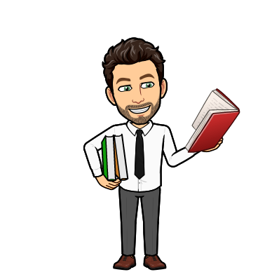


Further recommendations
Notes:
KS4

