Slide 1
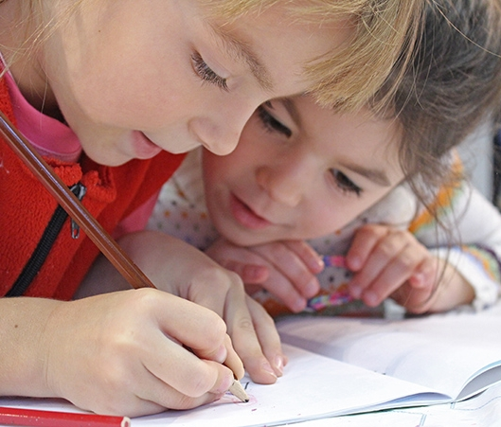
Reading Workshop
4th March 2021
The importance and skills of reading

Slide 2
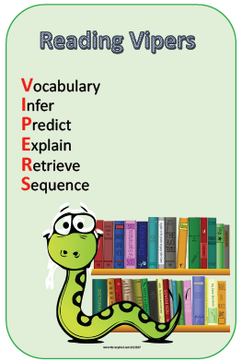

The Workshop Aims
The aims of this workshop are:
To understand the importance and regularity of reading for pleasure
To inform about reading expectations and provide hints and tips for reading at home.
To explore the content and expectations of formative and statutory assessment.
To model and explore key comprehension questions.

Slide 3
Statistics
Students are less able to learn other curricula if they do not develop sufficient reading skills by the middle of primary school
1 in 5 children cannot read well by the age of 11
Only 35% of 10-year-olds in England report they like reading ‘very much’.
Children who read books often at age 10 and more than once a week at age 16 gain higher in maths and spelling tests than those who read less regularly.

Slide 4
Research
Evidence suggests that there is a positive relationship between reading frequency, reading enjoyment and attainment (Cited in Clark and Douglas, 2011)
There is a growing body of evidence which illustrates the importance of reading for pleasure for both educational purposes as well as personal development (Cited in Clark and Rumbold, 2006)
Evidence suggests that reading for pleasure is an activity that has emotional and social consequences (Clark and Rumbold, 2006)
Other benefits to reading for pleasure include: text comprehension and grammar, positive reading attitudes, pleasure in reading in later life, increased general knowledge (Clark and Rumbold, 2006)

Slide 5
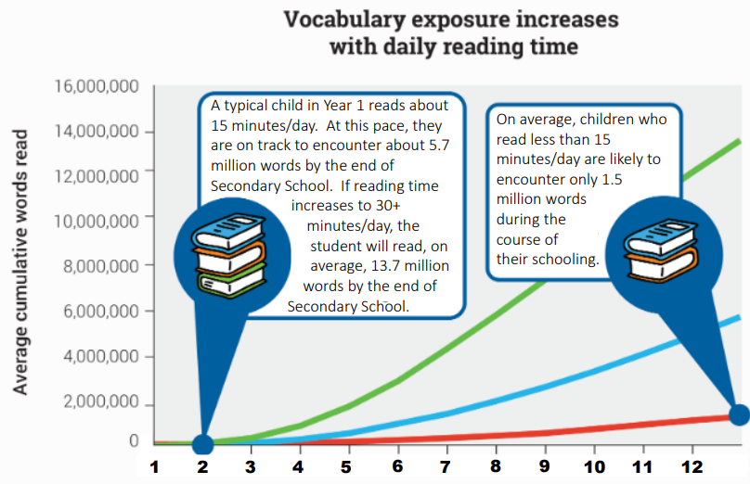
Research

Slide 6
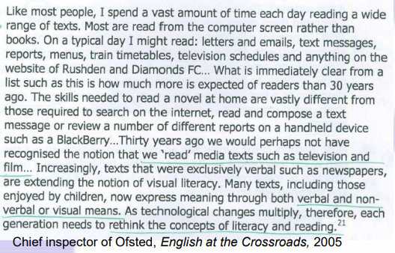
What can and should your child read?

Slide 7
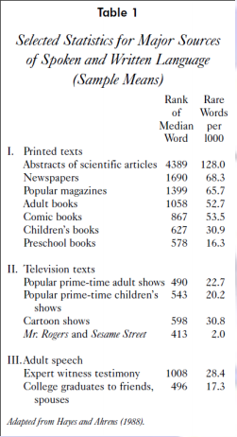
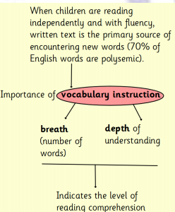
Level of language

Slide 8
Good websites

Slide 9



High level texts
It is also important to read to your child. This an opportunity for them to hear stories and language at a high level than they can read alone. Research shows the hearing of texts aloud is a significant source of vocabulary acquisition.
Use of audio books/Amazon Audible?

Slide 10
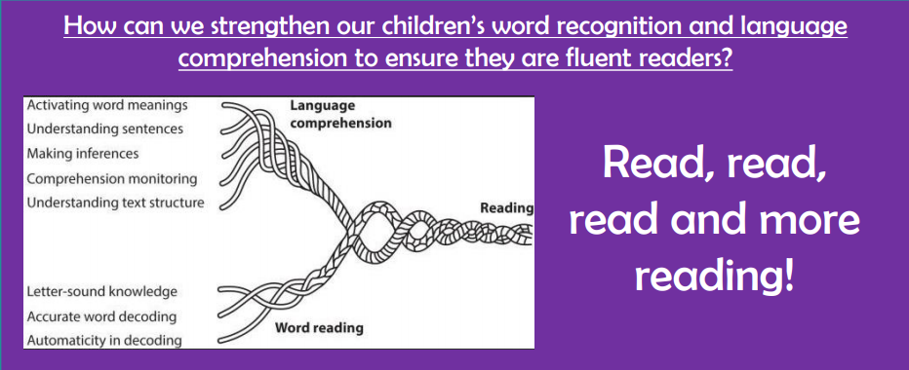
Support at home

Slide 11
Support reading at home
Read in front of your child
Reading regularly (at least 10-15 minutes per day)
Find a quiet, calm and comfortable space you and your child can read in.
Ensure your child has opportunities to read with adults as well as independently (no matter how confident a reader they

Slide 12
Support reading at home

Slide 13


Before reading

Slide 14


During reading

Slide 15

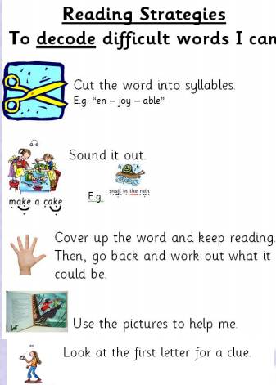

During reading

Slide 16
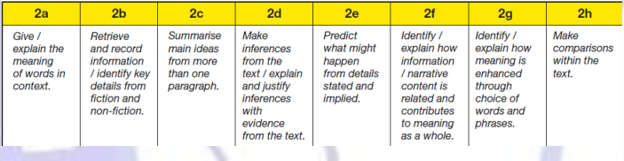
Skills of reading

Slide 17
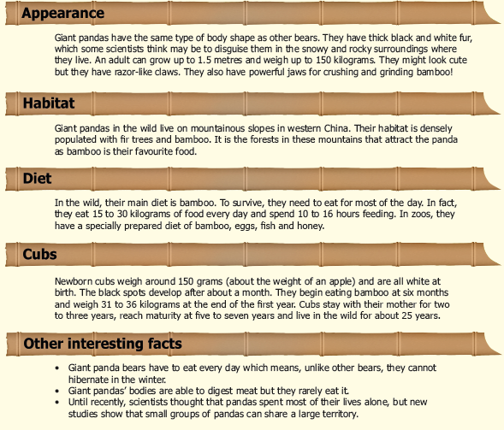
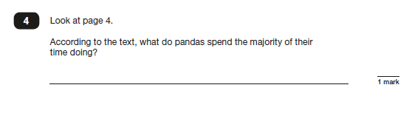
Practice time

Slide 18
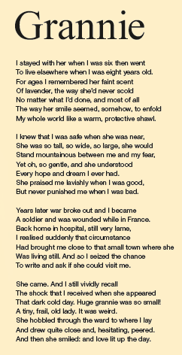
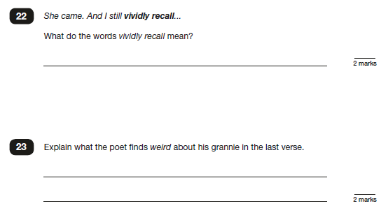
Practice time

Slide 19
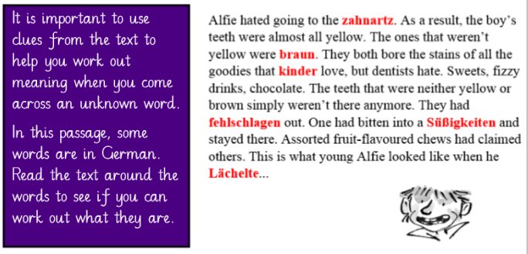
Working out word meanings
Challenge

Slide 20
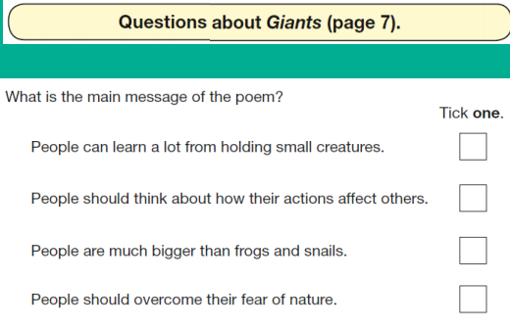
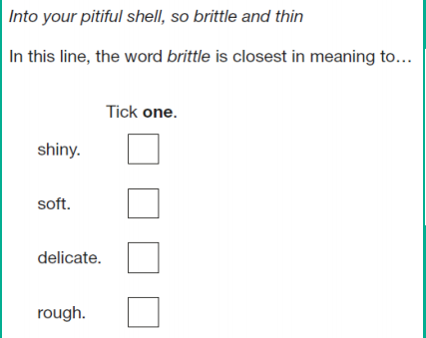
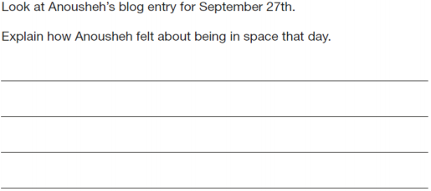
Reading skills

Slide 21















Audiobooks on World Book Day Website
Audiobooks – free for 30 days with free trial
Notes:
KS4

Slide 22

Thank You!
Mr Parmenter

